Slide 1
Know Your Roles
F2F Workshops

Slide 2
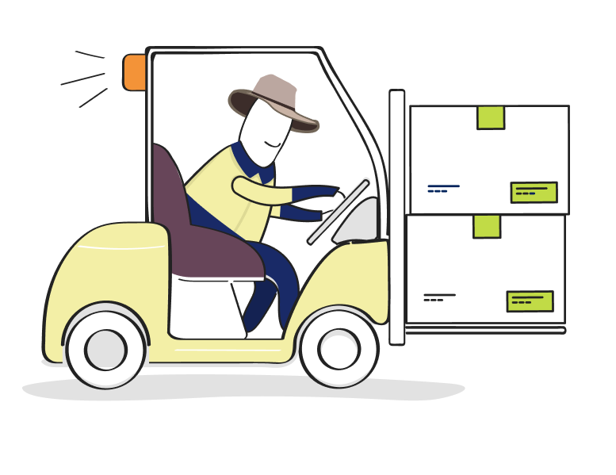
Know Your Roles Workshop
Purpose:
To understand what roles we play in the Chain of Responsibility (CoR), and to reduce public risk when transporting goods on heavy vehicles.

Slide 3
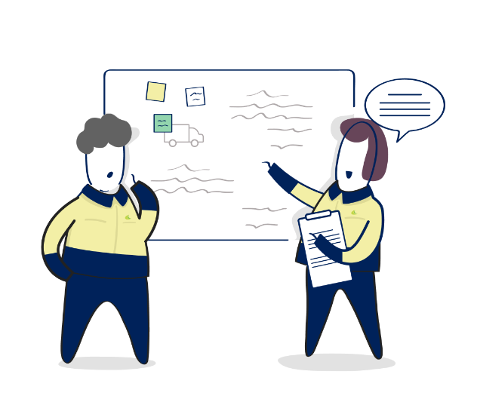
Know Your Roles Workshop
10 Parties in the CoR
Assessing and Managing Risks
Reasonably Practicable
Primary Duty

