Slide 1
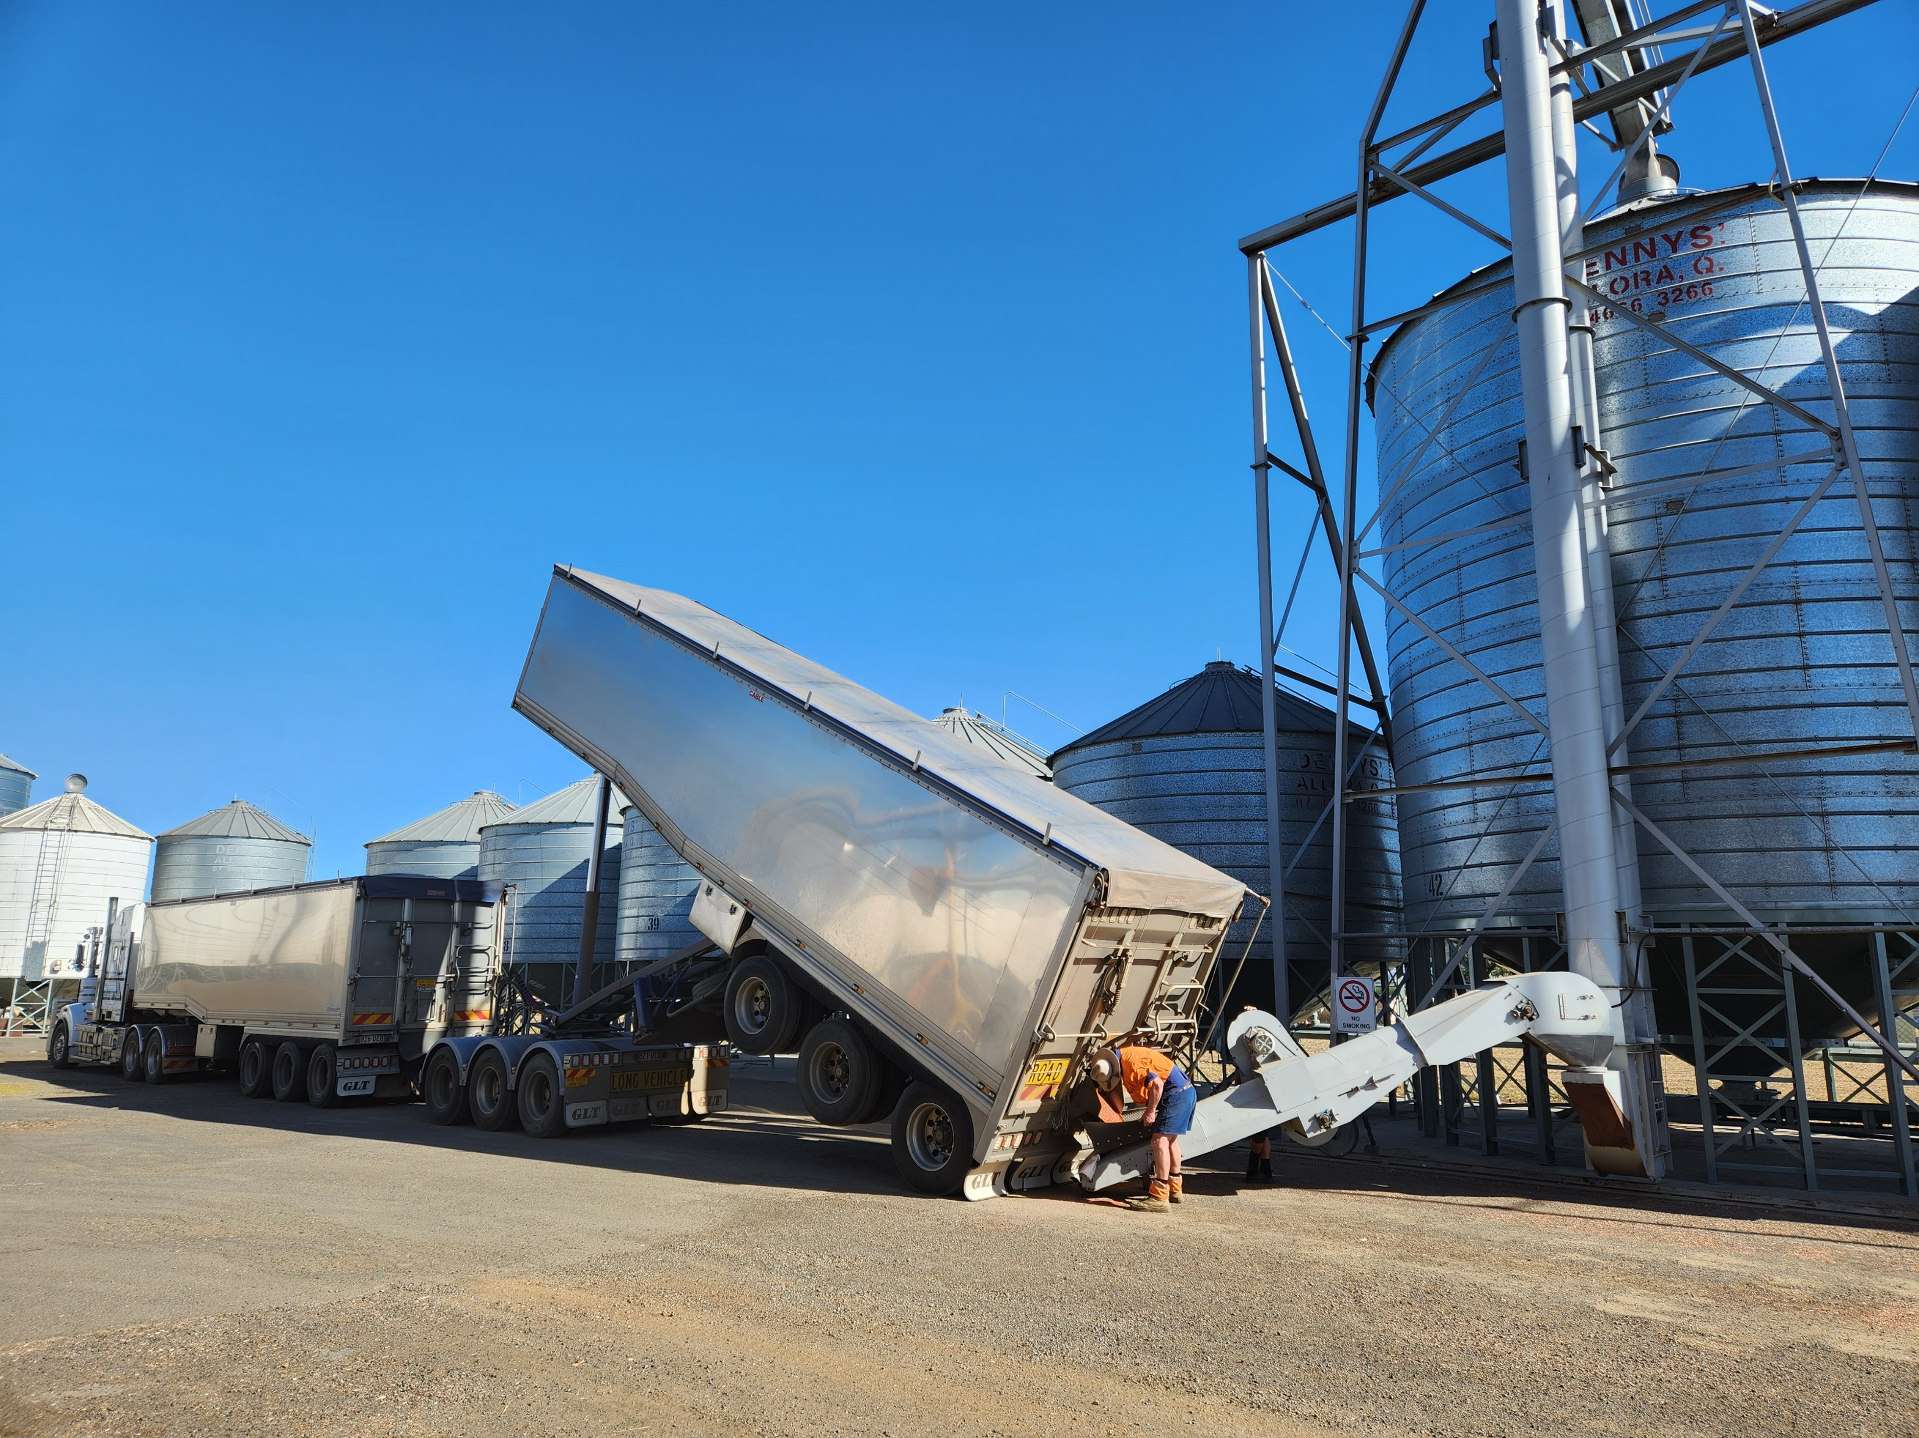

Your role in the Chain of Responsibility
A D V A N C I N G S U S T A I N A B L E A G R I B U S I N E S S
Notes:
What do you think COR is?

Slide 2

The Chain of Responsibility (CoR) is the part of the Heavy Vehicle National Law (HVNL) that makes parties other than drivers responsible for the safety of heavy vehicles on the road.
Everyone who works with heavy vehicles - from the business that employs a driver or owns a vehicle, to the business that sends or receives goods, is accountable for the safety of the heavy vehicle, its driver, and its load throughout the journey.
Notes:
It excludes drivers because they have a heap of other laws that apply to them. COR is about ensuring that nothing that they do causes a driver to breach the HVNL whilst on the road. But what is safety?
Safety means to eliminate public risk.
safety of drivers and passengers in heavy vehicles
safety of other road users and people near roads
protection of property including vehicles and loads
protection of road infrastructure
prevention of harm to the environment.
We all want to make sure the trucks that are on the roads are complying with the rules and be confident that they can show the roads with our family and kids.

Slide 3
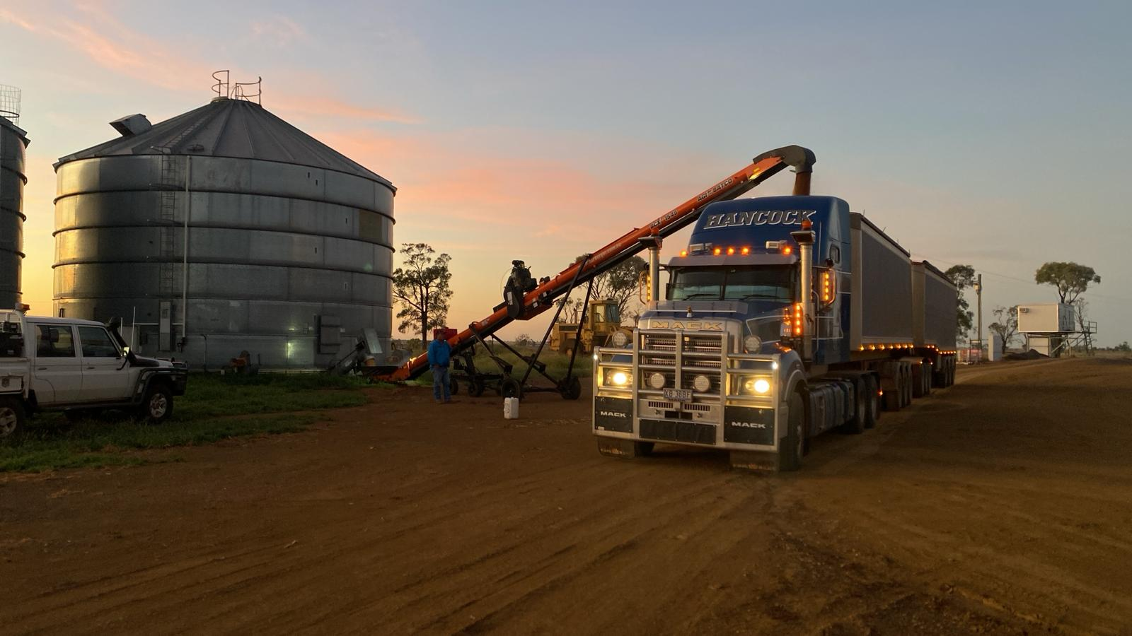

The Primary Duty is the obligation to ensure so far as is reasonably practicable the safety of your transport activities.
1 – Duty to eliminate public risk
2 – Duty to ensure you do not make anyone else breach HVNL
Notes:
Put simply: It’s your responsibility to do everything you can to make your transport work actions safe – this is your primary duty. You must:
manage the hazards and risks to the public that arise from your transport activities.
This law is very similar to the obligations that your business has under work health and safety laws. You must:
identify the risks involved in your transport activities
assess those risks
eliminate those risks, or if they can’t be completely eliminated, minimise them as much as possible.
Transport Activities include anything that you do in relation to the use of a heavy Vehicle including decisions you make
You must not:
take any actions that could influence drivers and others to speed or breach the HVNL, this could include:
direct requests or terms in a contract
financial penalties or rewards
preferential treatment
any other words or actions that might cause or encourage another CoR party, or a driver, to bend the rules.

Slide 4
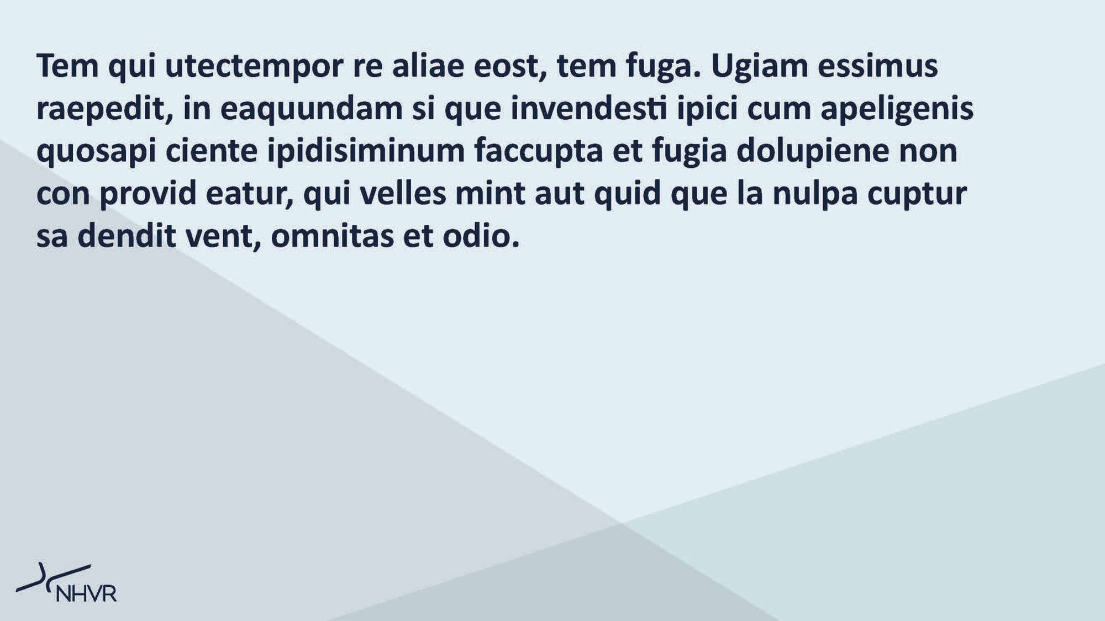


Executive Duty to Exercise Due Diligence s26D Heavy Vehicle National Law
Section 26D of the HVNL imposes a duty on executives to exercise due diligence to ensure the entity complies with its primary duty
  Understand the hazards and risks associated with their transport activities
  Have appropriate resources to eliminate/minimise hazards and risks
  Respond to information received about hazards and risks in a timely manner and verify that resources are provided, used and implemented
  Monitor the effectiveness of controls and continuously improve safety.
Notes:
Executive Duty Due Diligence is a positive, proactive, personal duty.
Even if the owner is not on the station or have anything to do with booking a truck, they still have a due diligence.
So as farm owners you have what’s called an executive duty to exercise due diligence.
WHS ensures that the worker does the task safely, CoR requires that the task is done is a way that ensures the safety of the public and focuses on the vehicle, driver or load whilst on the road.

Slide 5
Executive Duty to Exercise Due Diligence s26D Heavy Vehicle National Law
Section 26D of the HVNL imposes a duty on executives to exercise due diligence to ensure the entity complies with its primary duty
  Understand the hazards and risks associated with their transport activities
  Have appropriate resources to eliminate/minimise hazards and risks
  Respond to information received about hazards and risks in a timely manner and verify that resources are provided, used and implemented
  Monitor the effectiveness of controls and continuously improve safety.
Notes:
Executive Duty Due Diligence is a positive, proactive, personal duty.
Even if the owner is not on the station or have anything to do with booking a truck, they still have a due diligence.
So as farm owners you have what’s called an executive duty to exercise due diligence.
WHS ensures that the worker does the task safely, CoR requires that the task is done is a way that ensures the safety of the public and focuses on the vehicle, driver or load whilst on the road.

Slide 6
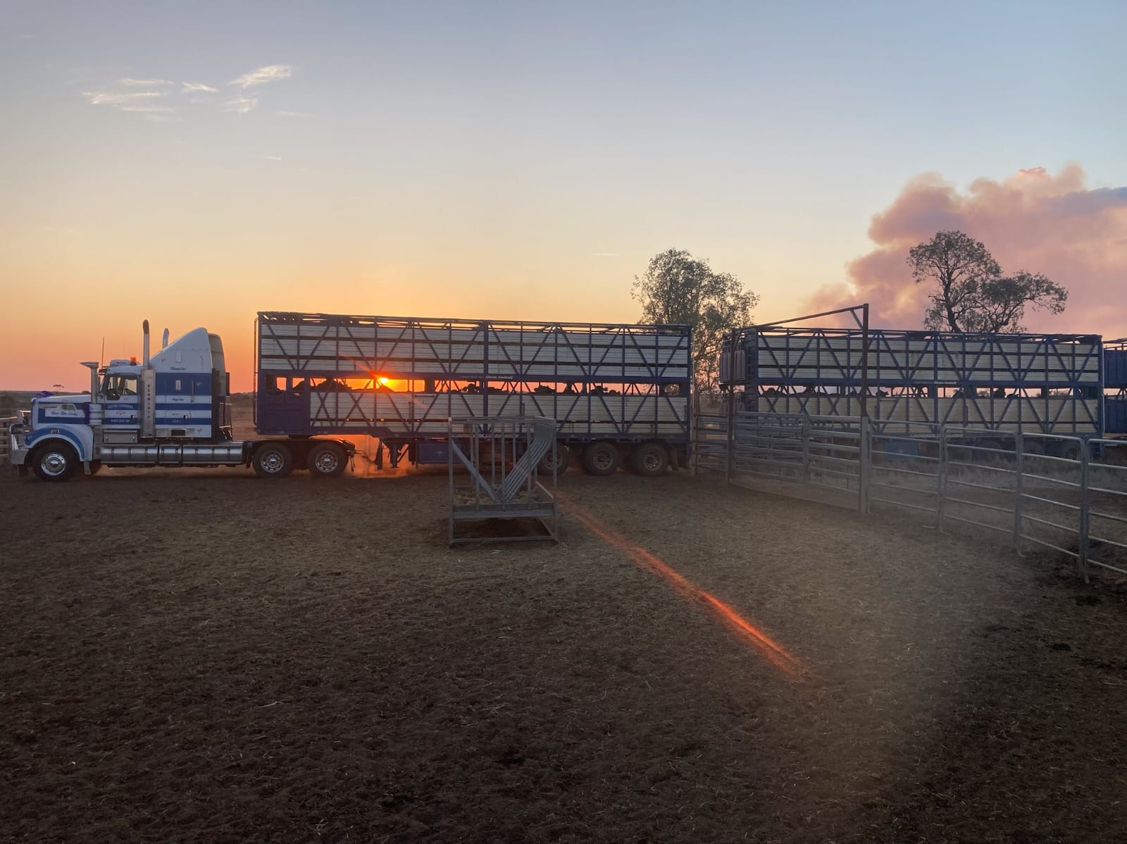
10 defined CoR functions
Employers
Prime Contractors
Schedulers
Loaders & unloaders
Loading managers
Operators
Consignors
Consignees
Packers
Notes:
Employer - employing a heavy vehicle driver
Prime Contractor - engaging a self-employed driver of a heavy vehicle under a contract for services
Scheduler - scheduling the transport of goods or passengers in a heavy vehicle, or scheduling a driver’s work and rest hours
Loader - loading a heavy vehicle
Unloader - unloading a heavy vehicle
Loading Manager - managing premises where five or more heavy vehicles are regularly loaded or unloaded each day
Operator - directing the control and use of a heavy vehicle
Consignor - consigning (coordinating and sending) goods for transport by a heavy vehicle
Consignee - receiving goods delivered by a heavy vehicle
Packer - packing or assembling goods for transport in a heavy vehicle
A driver is not a party in the chain unless they own the vehicle and then they would be an Operator or are doing one of the other functions.
The reason is that once a driver takes a vehicle out on the road they have to comply with the provisions in the HVNL.

Slide 7

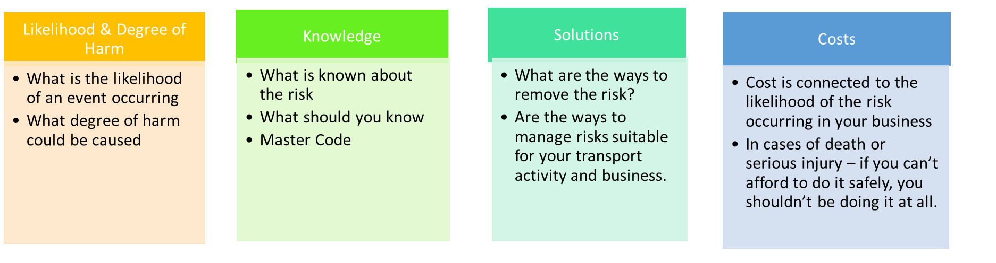
What is Reasonably Practicable?
Aligns with WHS Law
Concept is exactly the same
Don’t have to do everything possible, just the actions that are reasonably practicable.
Notes:
Review the slide and discuss.
Under workplace health and safety we look after the people.
Likelihood of a driver getting injured on your loading ramp? Pretty high with likely a serious injury. How can we control that risk?
CoR is about managing risks to the public while the vehicle is travelling on the road
We know rain is coming and your driveway is slippery and boggy for heavy vehicles. Its reasonably practicable for you to call and discuss road conditions with the operator.

Slide 8
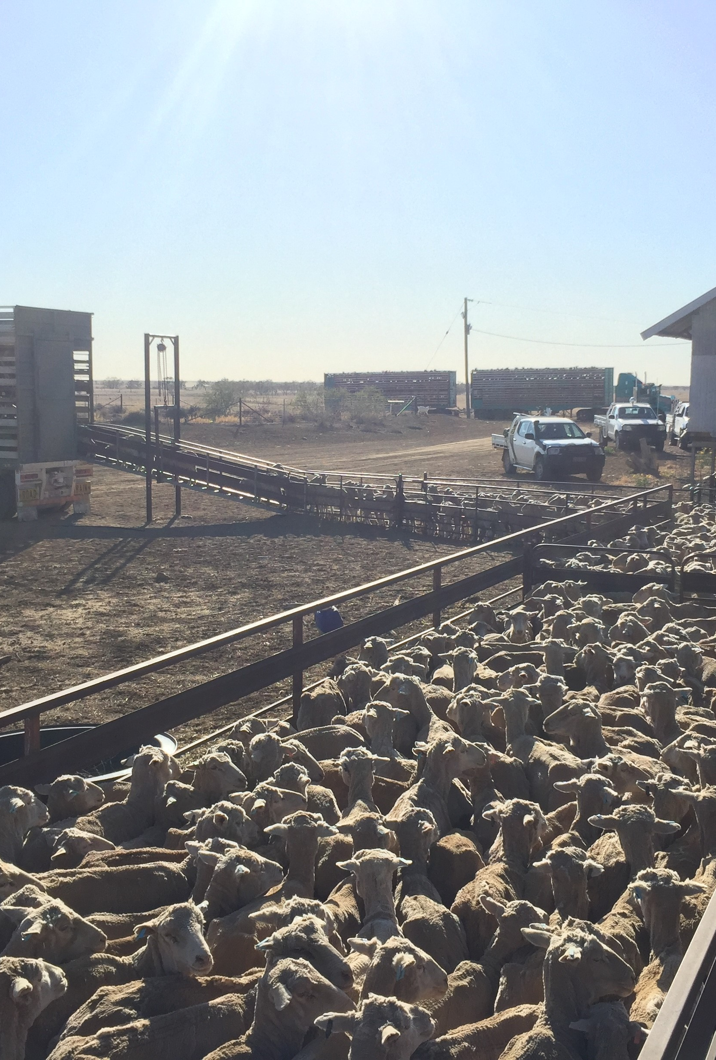
What is your duty and how do you fit in?
- Each party has the same duty (to ensure the safety of heavy vehicles), what is required of each of them to discharge the duty will differ.
- Depends on the extent of a business’s influence and control of a matter
- Duty may be shared with others, but not diminished. It reflects the level of control and influence you have.
Notes:
We all have the same duty – to ensure the safety of heavy vehicles whilst on the road and we also have shared responsibility. Discuss what participants think their level of control and influence is.
You cannot contract away your duty.
Discussion around control and influence.
Talk about the hierarchy of control – eliminate the risk and if it can't be eliminated minimise it
Every party has the same duty but each party will have varying levels of control and influence.
Shared responsibility is similar to the concept of over-lapping duty holders in WHS.
No single party is responsible for the safety of a heavy vehicle on the road
Talk About what other parties in the chain have shared responsibilities
The influence they have on other parties
The influence other parties have on their business
What each party is doing to ensure safety of the transport activities on a road.
Communication is key.
Workshop ways they can communicate with people involved.

Slide 9

Primary Producer obligation in CoR who owns / operates heavy vehicle:
The most relevant areas of responsibility for you as a primary producer will include:
- what and how much is loaded onto the vehicle, how the weight is distributed and how the load is restrained
- that the vehicle is fit for purpose, mechanically safe and legally able to be used on a road
- that the driver, who may be you, is not tired and doesn’t work longer than allowed by law
- that you understand the safety risks your activities pose to the transport task, including packing goods for transport, scheduling travel and delivery times, and the impacts of delays in loading and unloading trucks
- that you avoid requests, instructions, requirements or demands that may influence the driver to speed or drive while fatigued — whether written in a contract or made verbally.
Notes:
Discuss what is reasonably practicable in this example.
Under CoR Its reasonably practicable for a lay person to see and understand a tyre is missing or a windscreen is cracked. You might hear the brakes are worn. Those are reasonably practicable things anyone working on a farm who has been around heavy vehicles for any length of time should know.
Its not reasonably practicable for us to know the lead springs needed maintenance or that hydraulic fluid was leaking.
Its not reasonably practicable for us to know the driver had exceeded his maximum hours if he just showed up at our place but everything about this particular instance should ring massive alarm bells. Discuss possible courses of action.

Slide 10
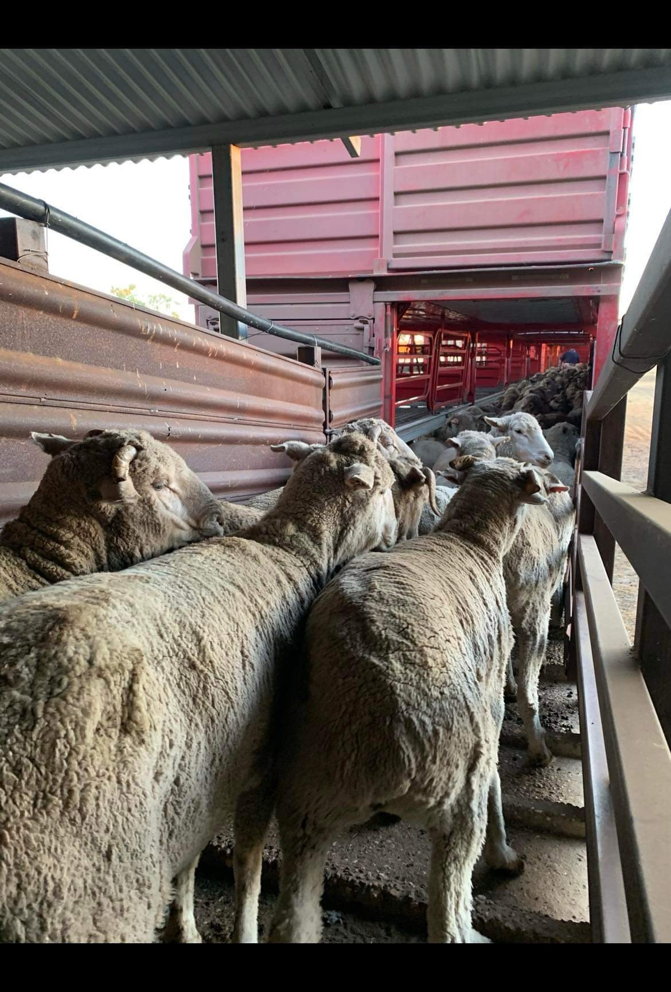
Primary Producer obligation in CoR who contracts heavy vehicle transport services:
Consult your provider to ensure any safety risks are understood and steps are taken to mitigate those risks. Some relevant areas of responsibility for you as a primary producer may include:
- avoiding requests, instructions, requirements or demands that may influence the driver to speed or drive while fatigued — whether written in a contract or made verbally
- ensuring stock or loads are ready to load on time so that a driver is not unduly delayed and pressured to speed or exceed fatigue hours
- taking account of effluent production when preparing livestock for transportation
- ensuring safe access, while on your property, for heavy vehicles and drivers, and advising them of relevant local knowledge
- ensuring you consult with your transporter and other parties in the chain when setting timeframes for pickup and delivery
- use operators that provide safe and compliant transport activities.
Notes:
Discussion around effluent CoP here. Refer to mapping your transport activites (next slide)

Slide 11
Map your transport activities
Do you own or operate heavy vehicles?
Purchase vehicles
Modify vehicles
Train drivers
Schedule journeys – route and time
Load vehicles
Restrain loads
Vehicle maintenance
Do you send or receive goods in heavy vehicles?
Pack or consign loads
Receive goods
Unload goods
Schedule journeys – route and time
Do you contract others to drive heavy vehicles?
Schedule journeys route and time
Contract terms
Do you manage loading and unloading premises?
Manage fatigue
Safe loading
Trained employees
Rest Facilities
Notes:
These are the things you need to think about for your transport activities.
You should also have a process recorded somewhere as part of your safety management system.
Activity:
Show them the 9 Step SMS from NHVR & do step 2 & 3 identify risks & hazards.
Discuss ways you can document your transport activities.
Discuss the obligation to train everyone in the organisation their role in COR.
And have it documented!!
The reality is that you do most of these things already.
You just need some sort of formalised process.
Activity:
Run through the NHVR Safety Policy & Responsibilities template.
Talk about mapping out their transport activities
Discuss when someone contracts transportation, what should be put in writing to have clear understanding and the importance of regular communication and collaboration.
Each operator will have a way that works best for them. If you are contracting them, you should know what that is.

Slide 12
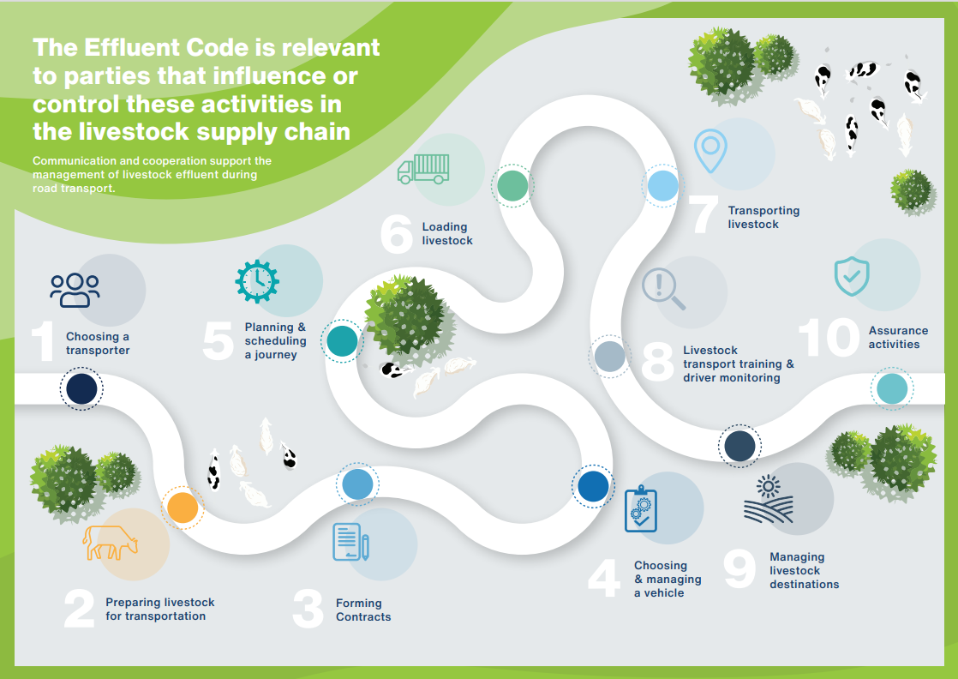
Notes:
Talk through how they can engage and map transport activities with cattle or sheep carters to ensure they are meeting the Effluent code of practice.
Discuss reasonable steps.

Slide 13
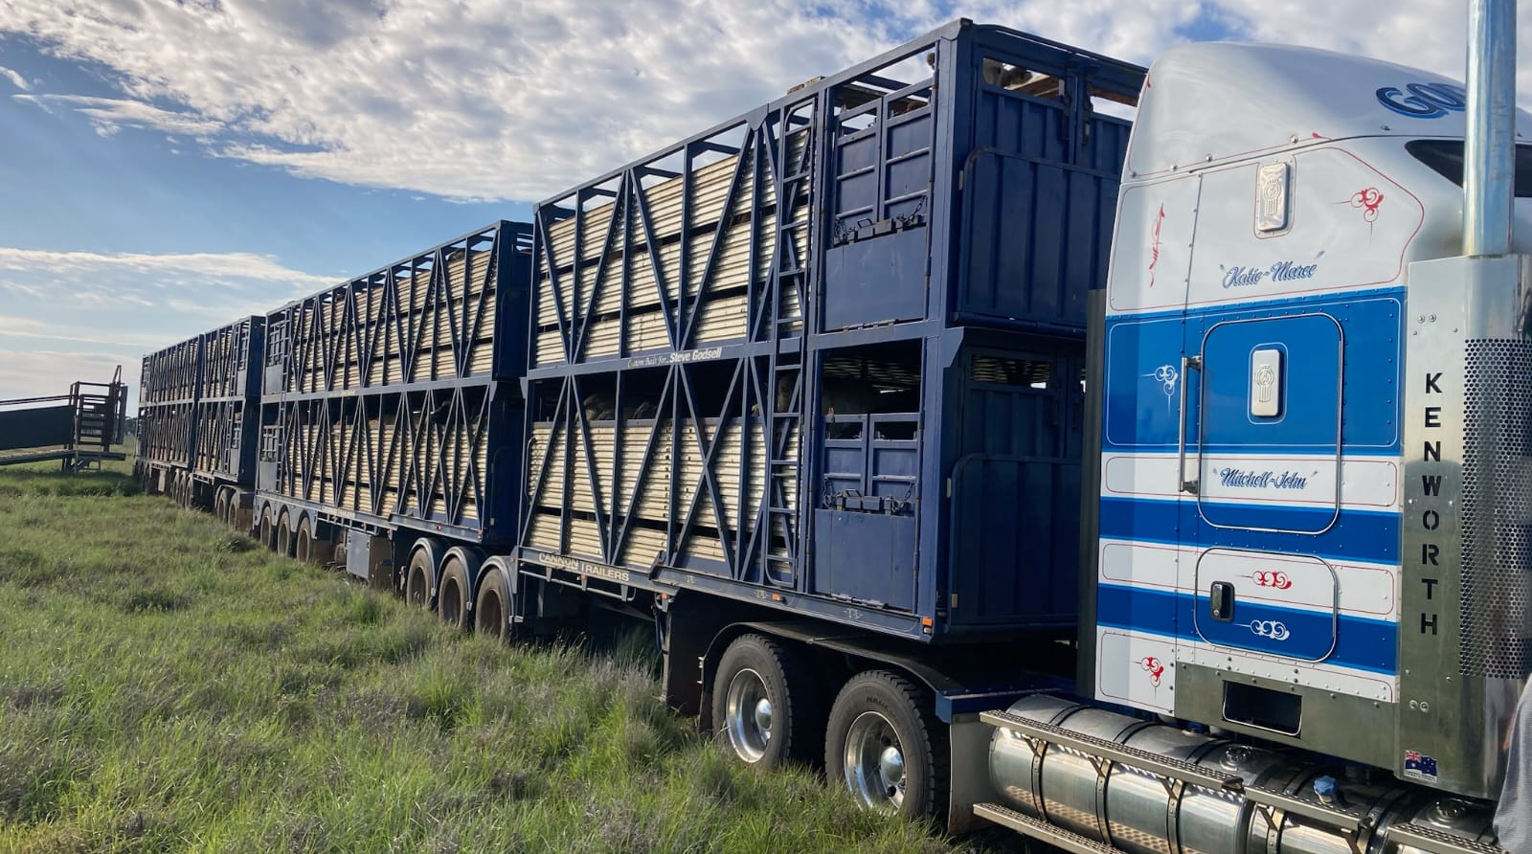
AGFORCE SECTION HEADER
Prosecution Examples
Notes:
Talk about real world examples of what some of this means in a prosecution sense.

Slide 14
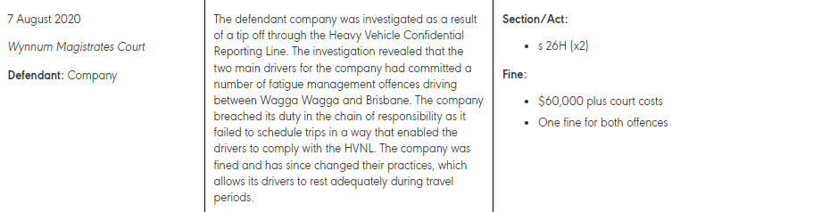
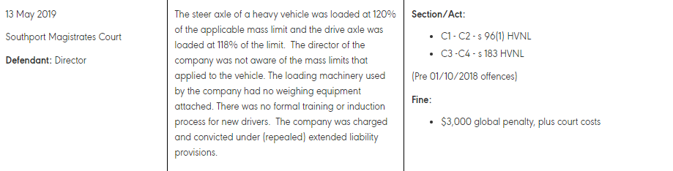
Notes:
Discuss examples and ways action could have been taken

Slide 15
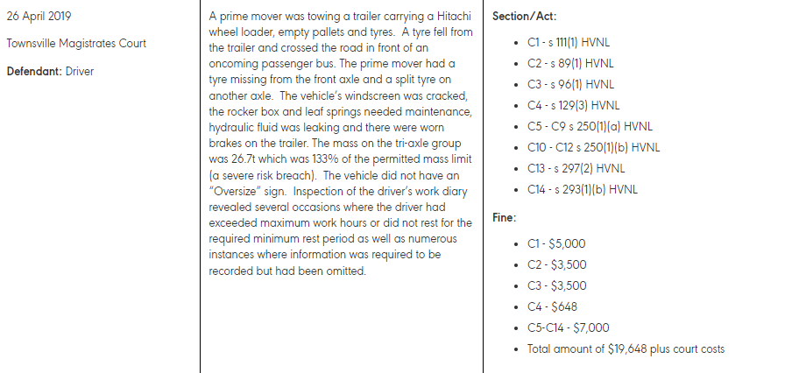
Notes:
Discuss example and what we should have done if this truck and this driver showed up on our place.

Slide 16
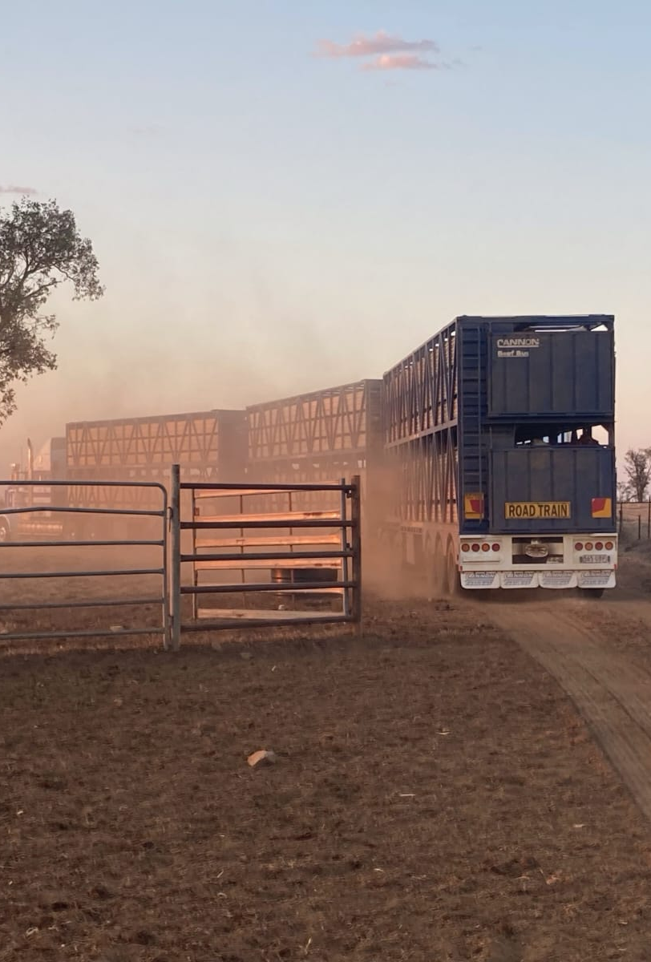
Signs of Impairment / Fatigue
Contractors or Drivers coming to your property:
- Slurred Speech
- Bloodshot eyes
- Poor concentration & coordination
- Slow response times
- Restlessness
- Odour of alcoholic drinks
- Aggressive or inappropriate behaviour
If you are a driver:
- Judgement & lane position problems
- Speed and braking inconsistencies
- Slow reaction times
- Not remembering a portion of the journey
- Blurred Vision & yawning
- Not feeling refreshed after nap / sleep
Notes:
Discuss ways to broach the conversation with the driver, how to escalate concerns, who to call, NHVR confidential reporting line.
Making sure that you alert the employer of the driver, the owner of the vehicle.
Also make sure that anyone on site knows and understand the signs of impairment and fatigue.

Slide 17
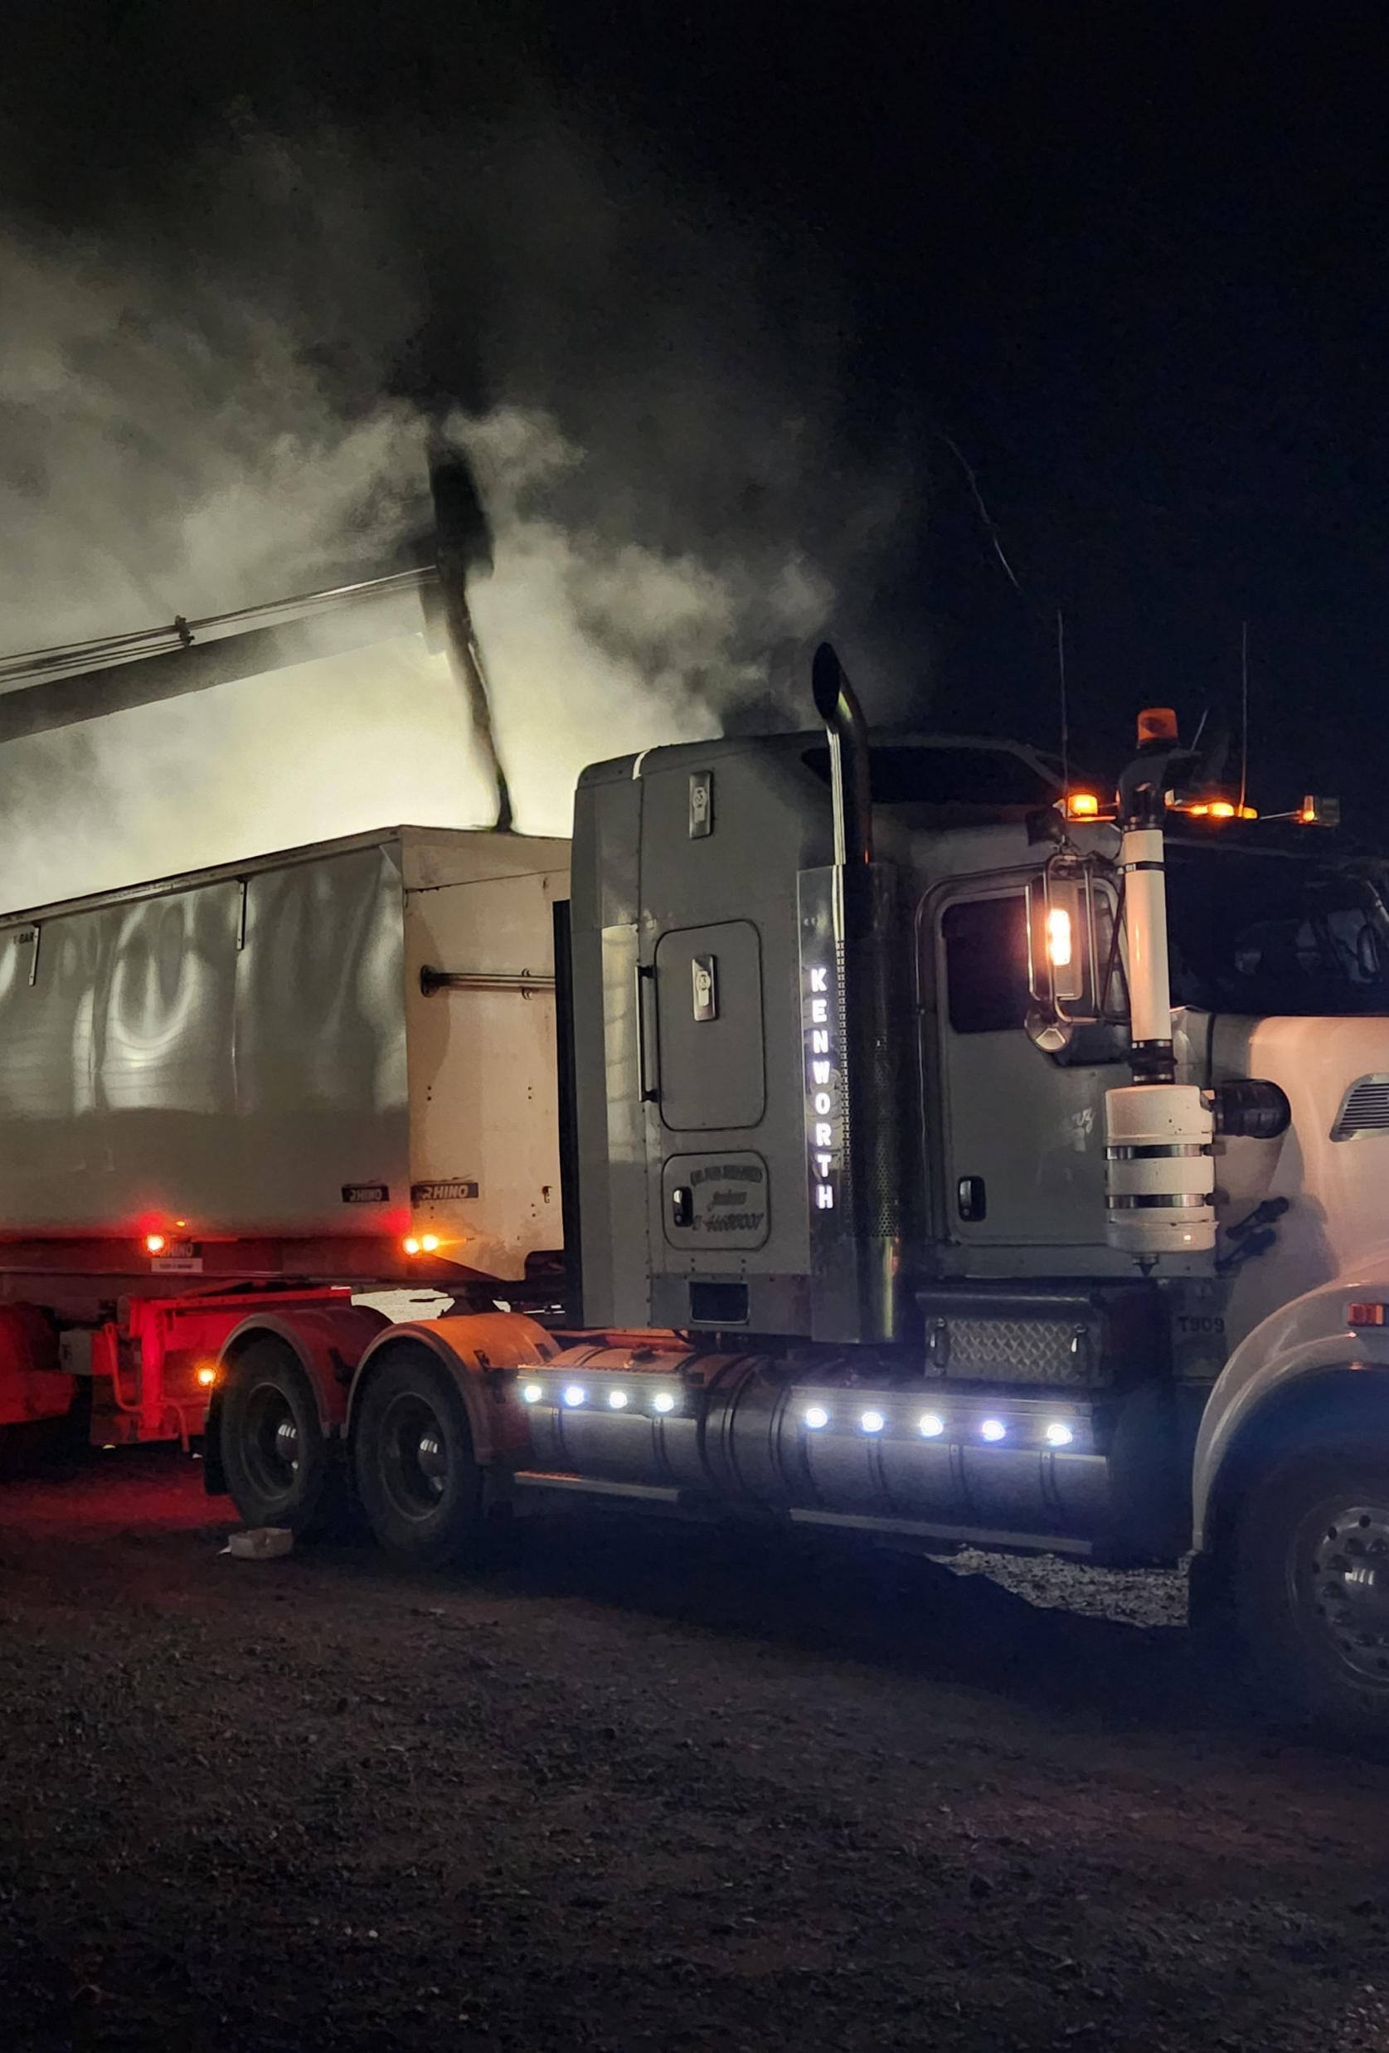
Safety Management System
- Assessing hazards and risks
- Discussing hazards and risks with other parties
- Identifying reasonably practicable ways to eliminate risks
- Documenting policies & procedures
- Training
Notes:
Activity:
Risk Assessment work sheet. Talk about the AgForce SMS & the NHVR free SMS
Run through how it works and what you should be recording.

Slide 18
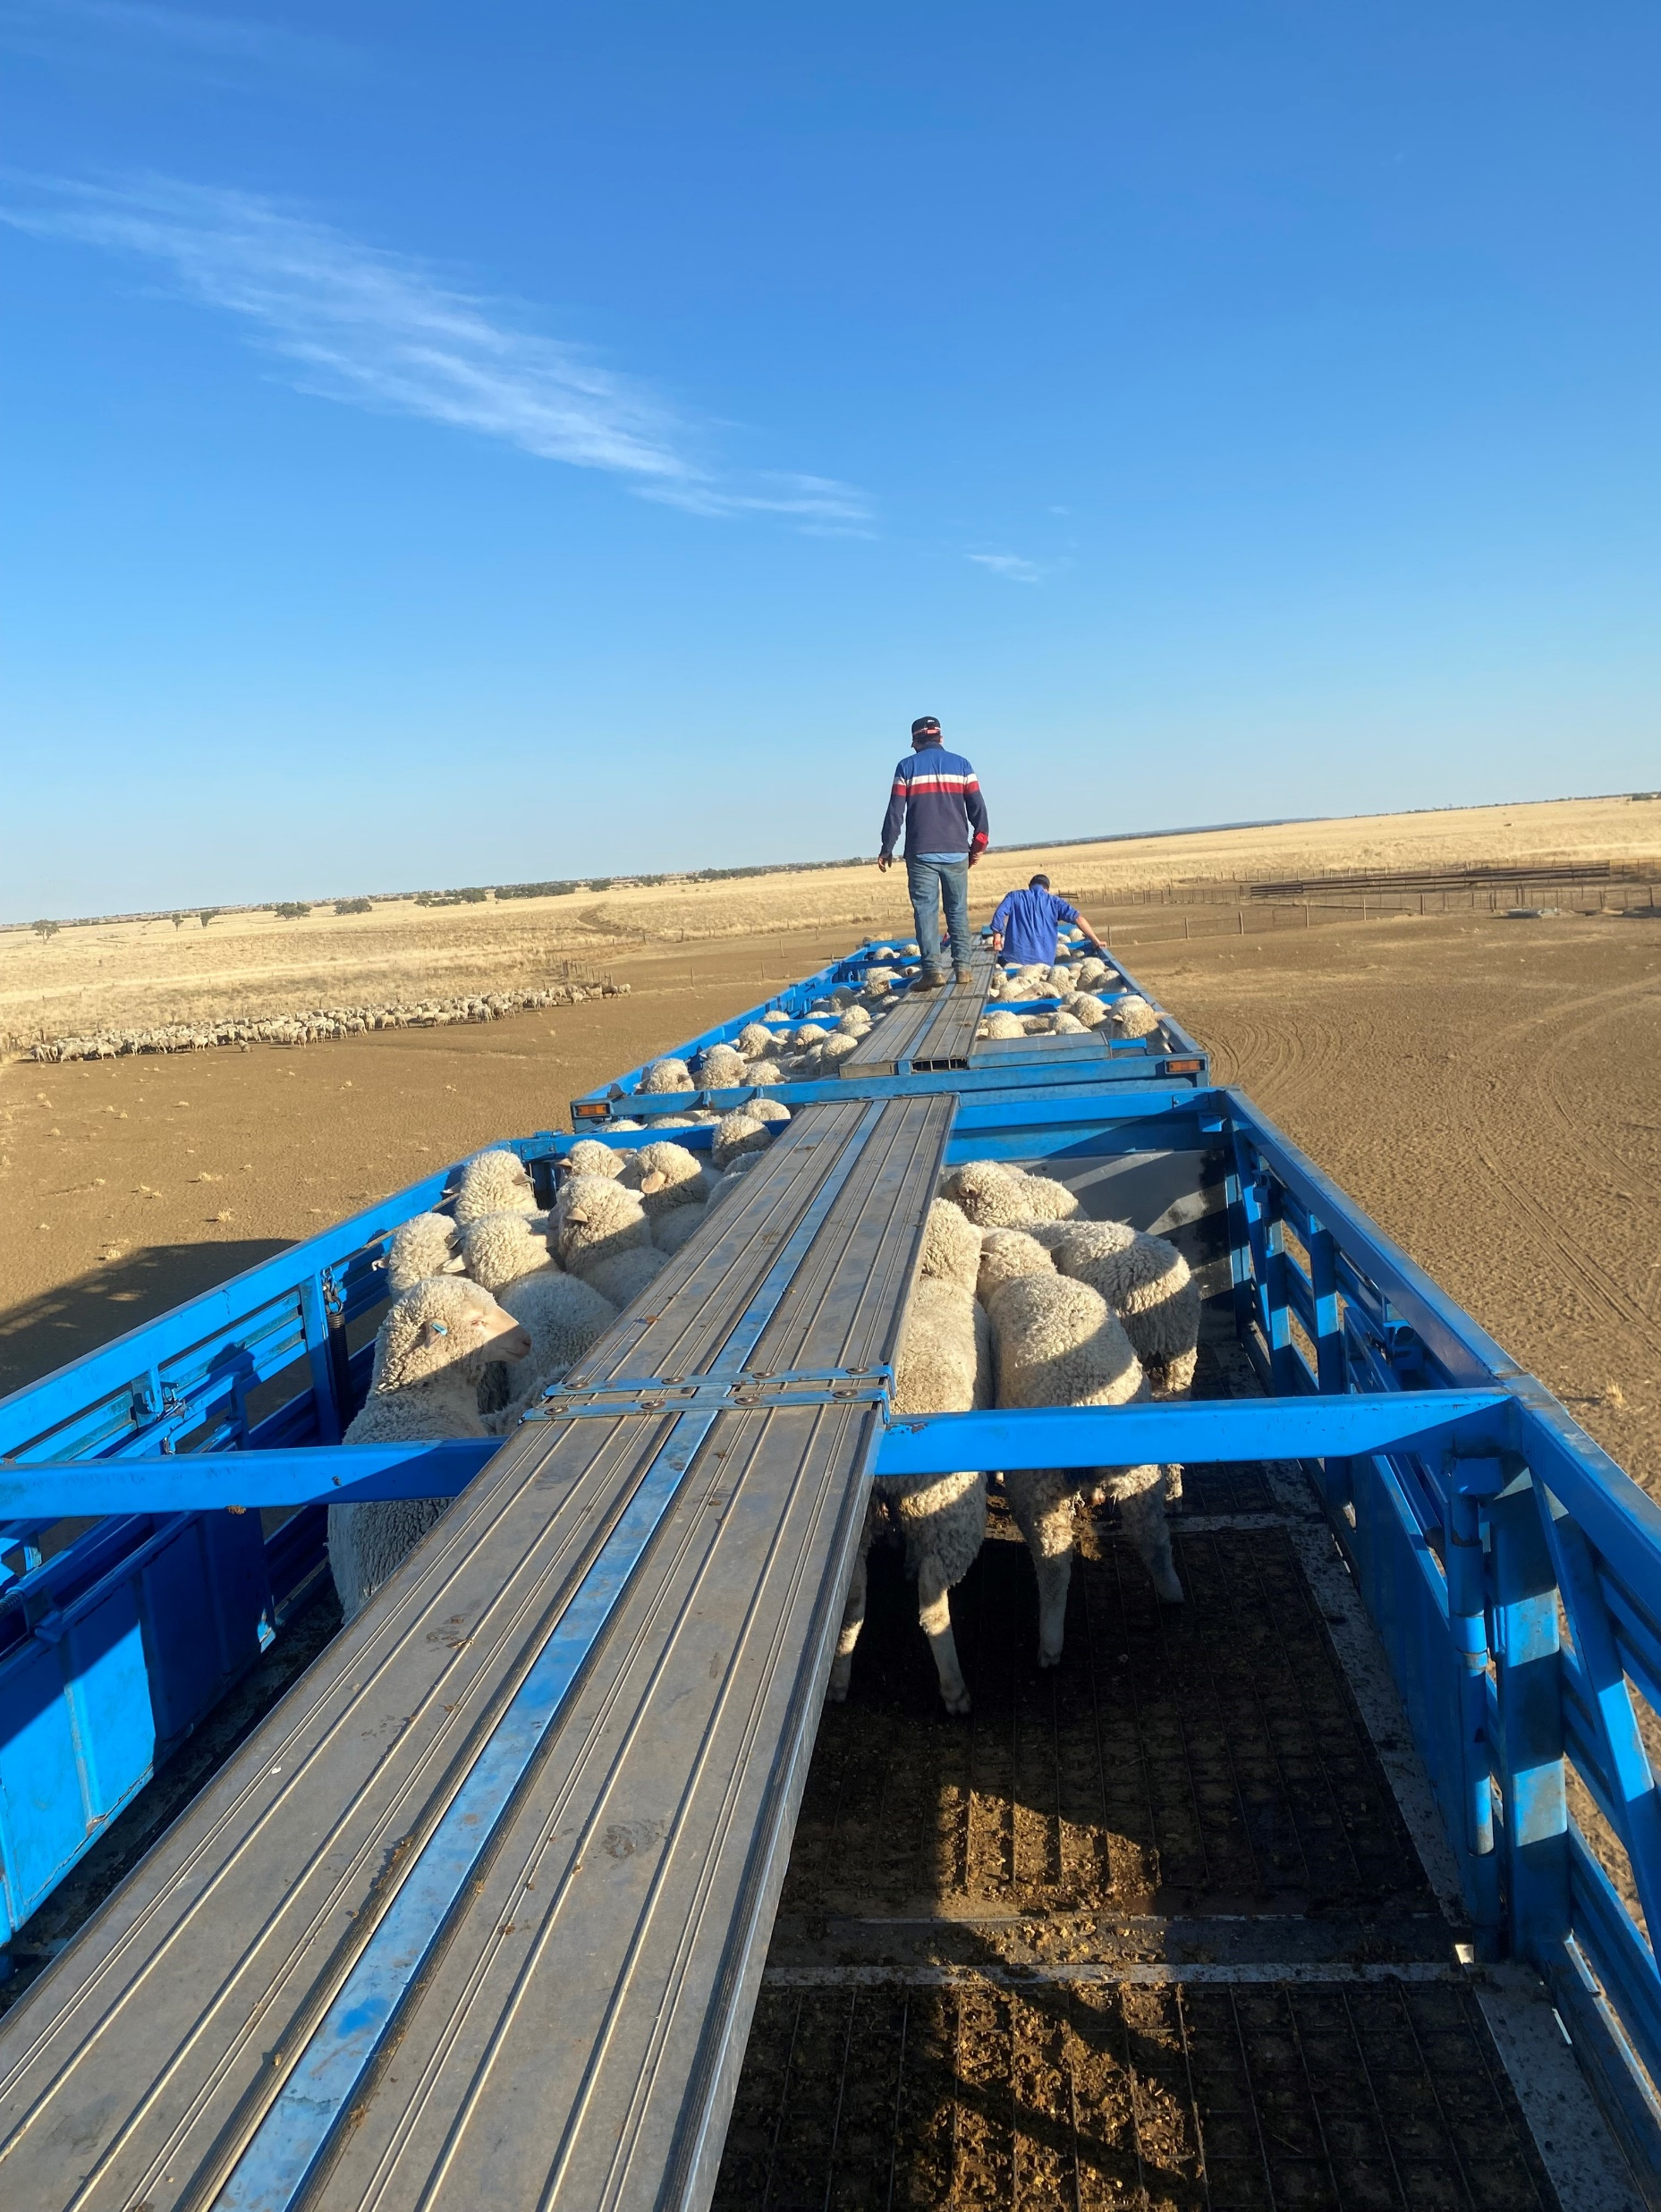
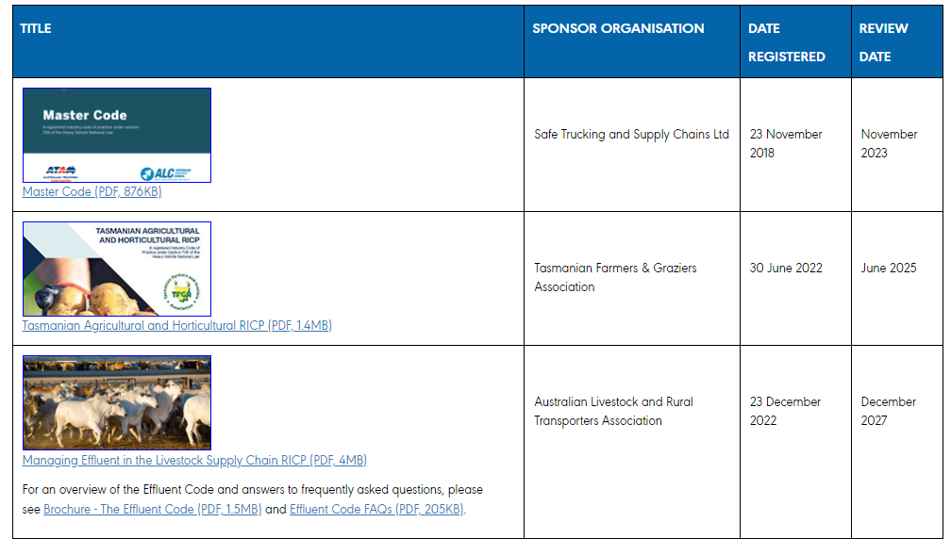
nhvr.gov.au
Notes:
Live demo of the NHVR website and where they can get information around the codes of practice
Regulatory advice for primary producers examples

Slide 19
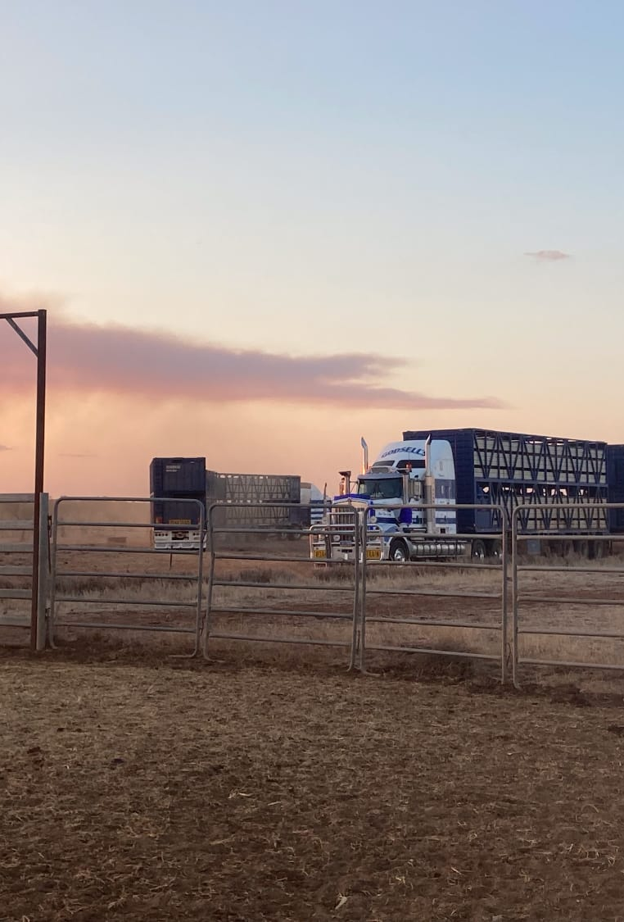
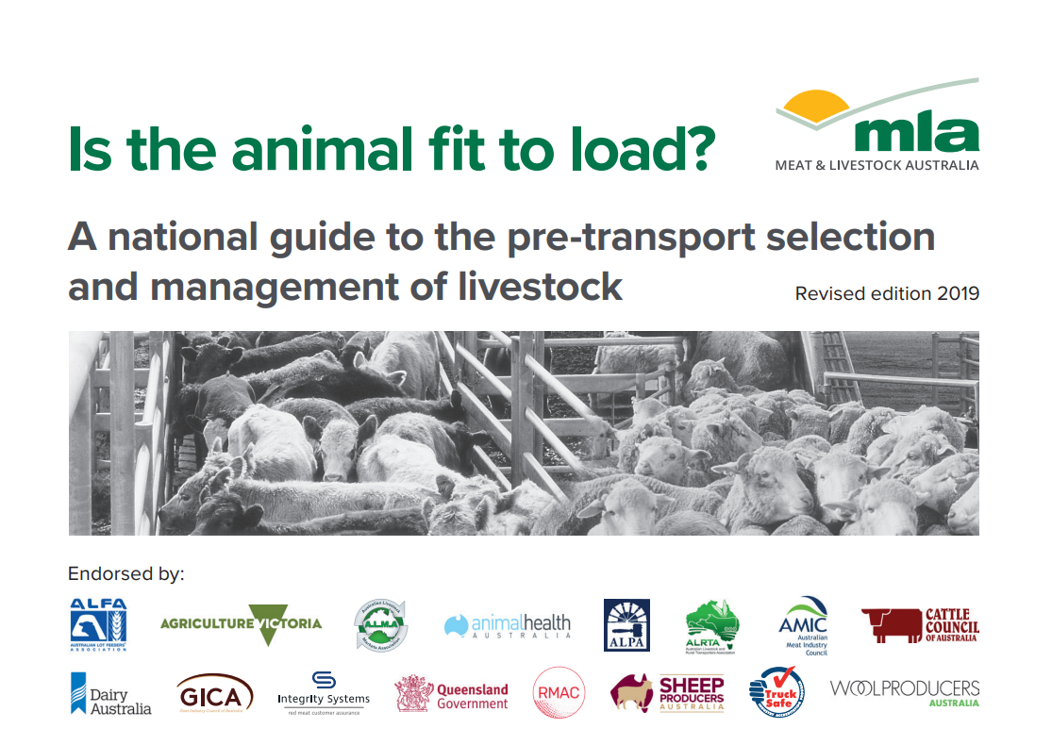
MLA Fit to Load
Notes:
Review MLA fit to load guide

Slide 20
End.
A D V A N C I N G S U S T A I N A B L E A G R I B U S I N E S S

