Slide 1
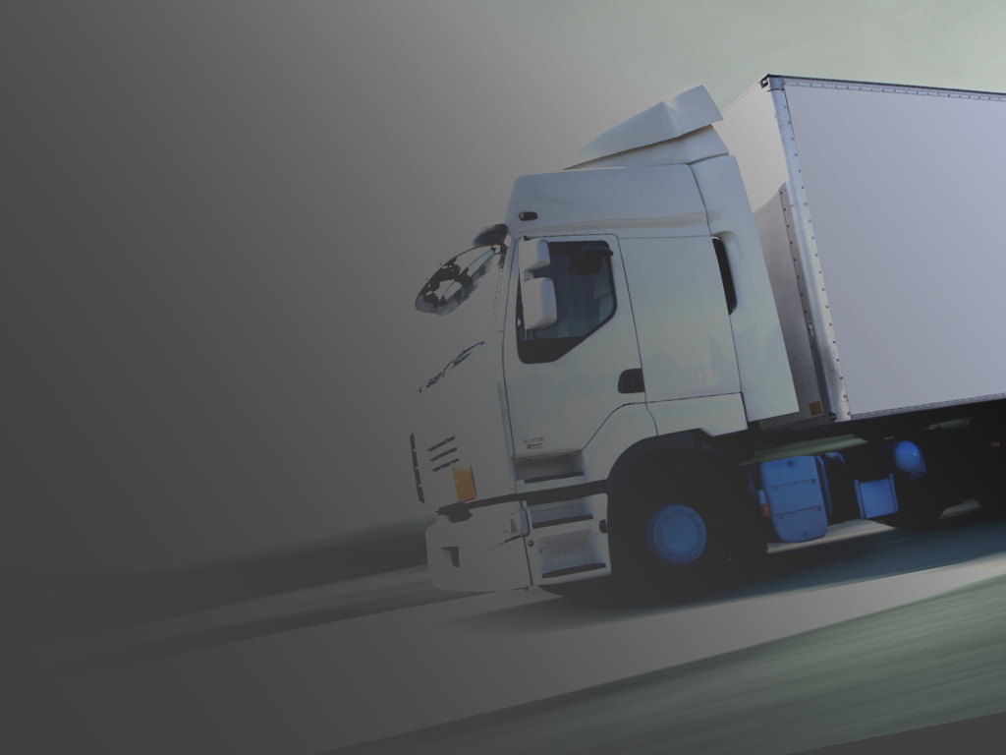
Mapping Heavy Vehicle Ops
Redwand Consulting 2024
Notes:
Introductions
Evacuation and other HR related information
Reason why we are here/ why you.
Expectations
General information on the day ahead
How to interact - groups/individual/ led by whom
Any questions before proceeding?

Slide 2
What HV transport activities does your organisation undertake?
Type of transport task undertaken
For what purpose – general and/or emergency ops?
Where to and where from?
Carrying what – machinery, pax, products?
Using what vehicles – size, configuration …..?
How often?
By whom – internal or external?
On what type of roads – public, private, tracks …?
Notes:
Formal and structured process for developing a system to comprehensively manage safety and compliance.
Map the transport task – where do use heavy vehicles in your business?
Compare the task, associated policies, procedures and competencies to the requirements under the HVNL – Gap Analysis
Conduct a risk assessment of the discrepancies in the gap analysis using organizational risk framework and accepted risk assessment methodologies under AS31000
Brief and gain executive support for an action plan
Mapping the HV transport task - Before you can manage the risks associated with heavy vehicle operations you need to fully understand:
your transort activities – anything the business does in relation to the use of a heavy vehicle, including decision making
what you do
identify all parties in the chain are that influence the task – both internal and external
identify any hazards and risks to the public
implement controls
Generate a comprehensive spread sheet where each of these areas is recorded
This will form the basis for determining if the organization has appropriate systems in place to support these operations.

Slide 3
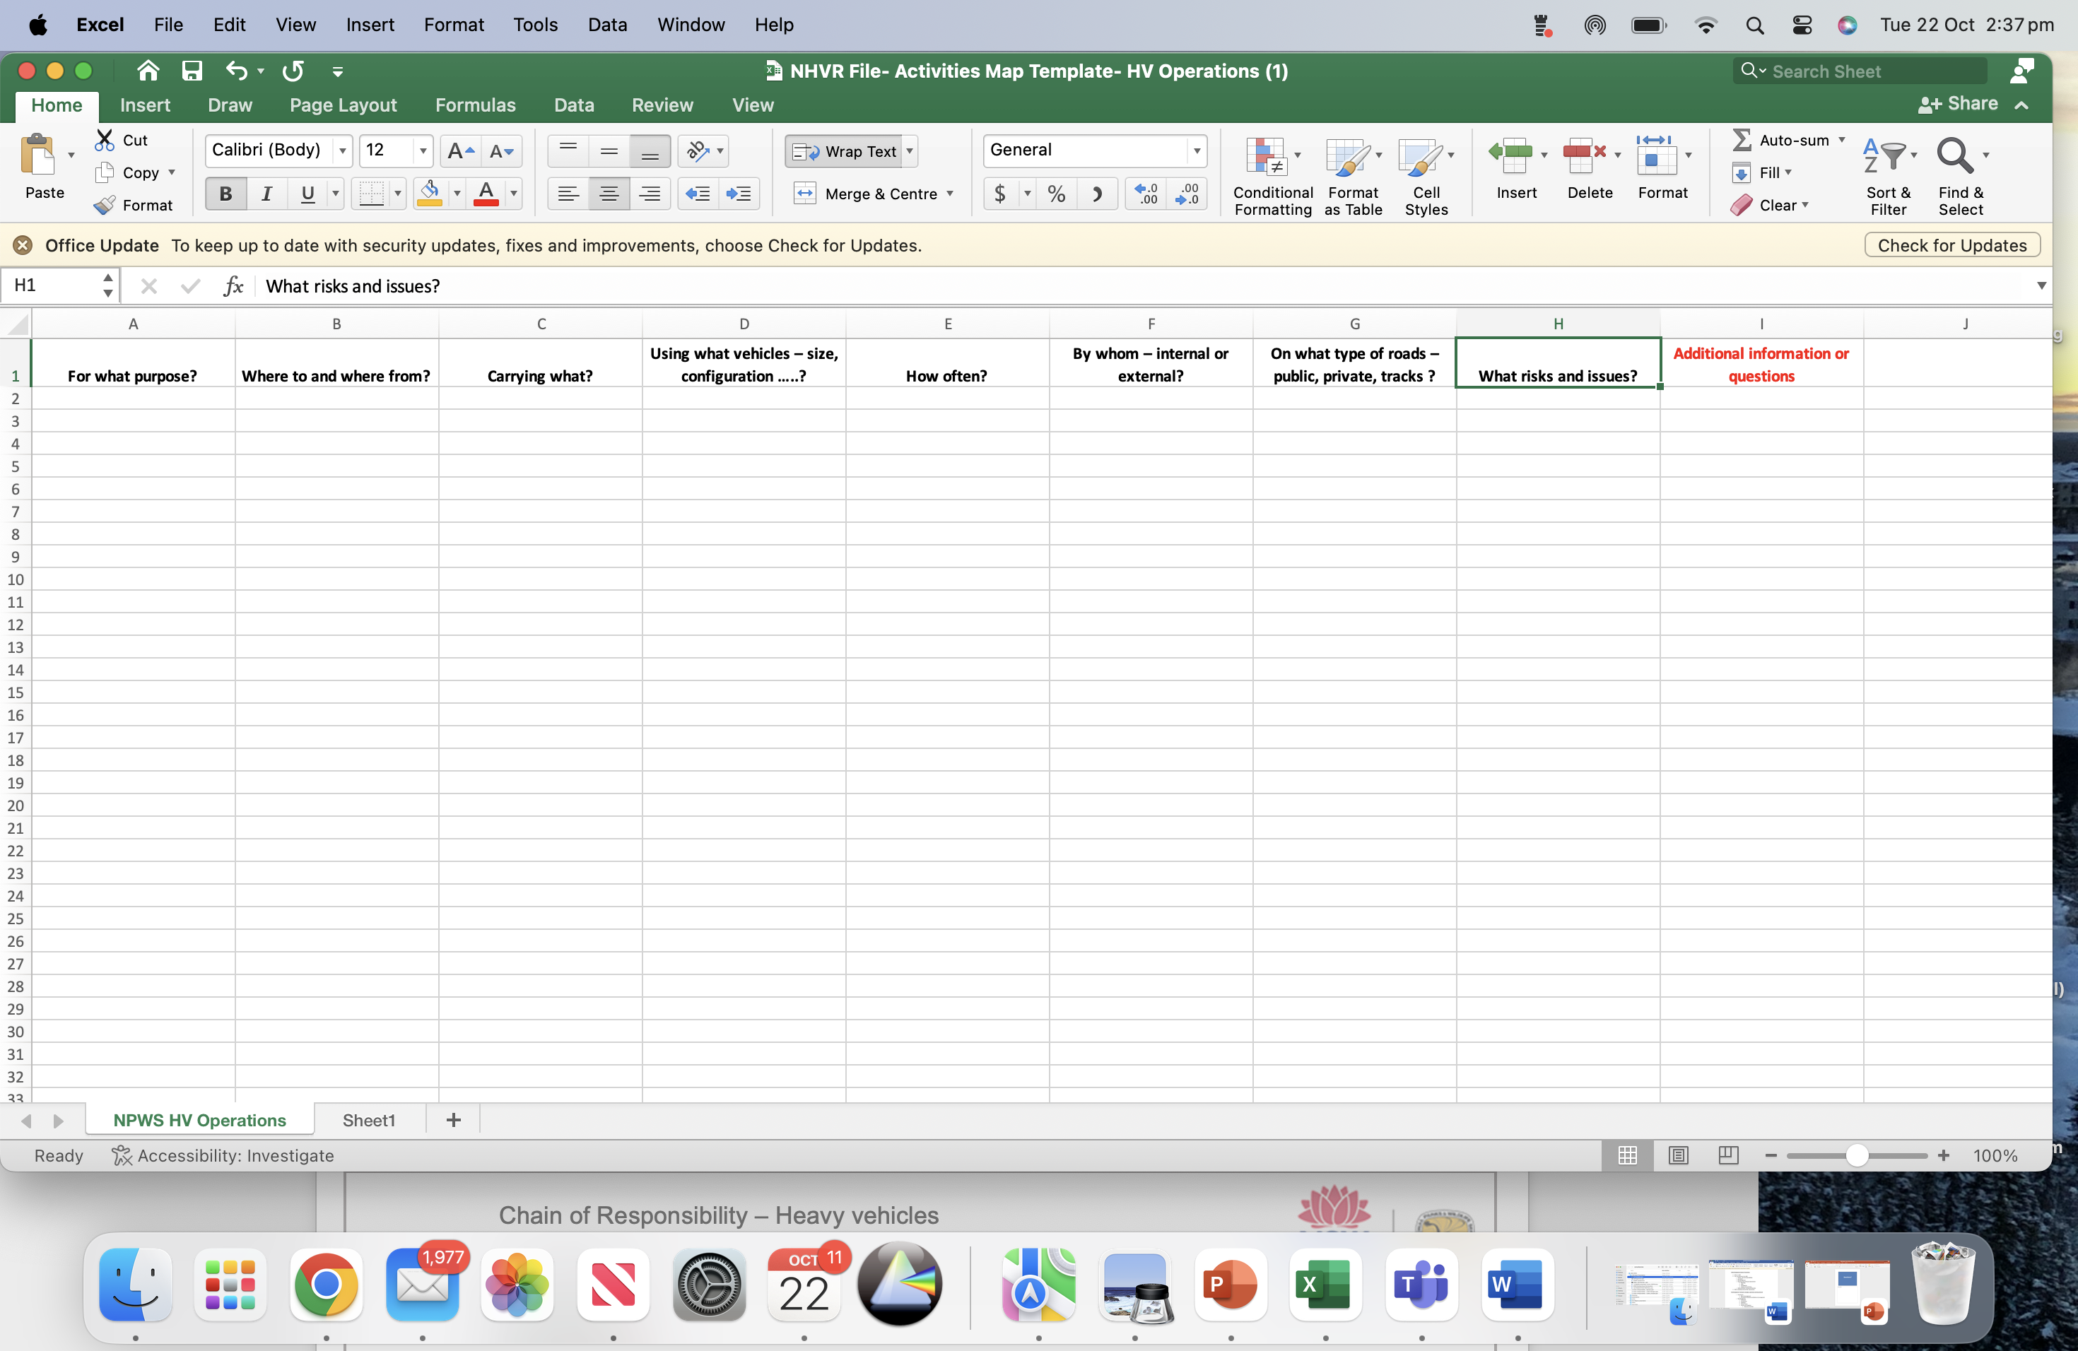
Sample spreadsheet

Slide 4
Questions?

